Slide 1

Hospital Patient Care & Operational Analysis: Unlocking Insights from 101,700+ Records
Concise analytics brief highlighting patient acuity, clinical resource use, and operational efficiency to guide staffing, care pathways, and financial decisions.

Slide 2

Project Overview: Transforming Data into Actionable Healthcare Insights
Scope
Primary Goals
101,766 patient records • 49 clinical & operational features
Understand acuity, resource utilization, and operational efficiency
Outcome
Actionable recommendations to improve stays, medication management, and resource allocation

Slide 3
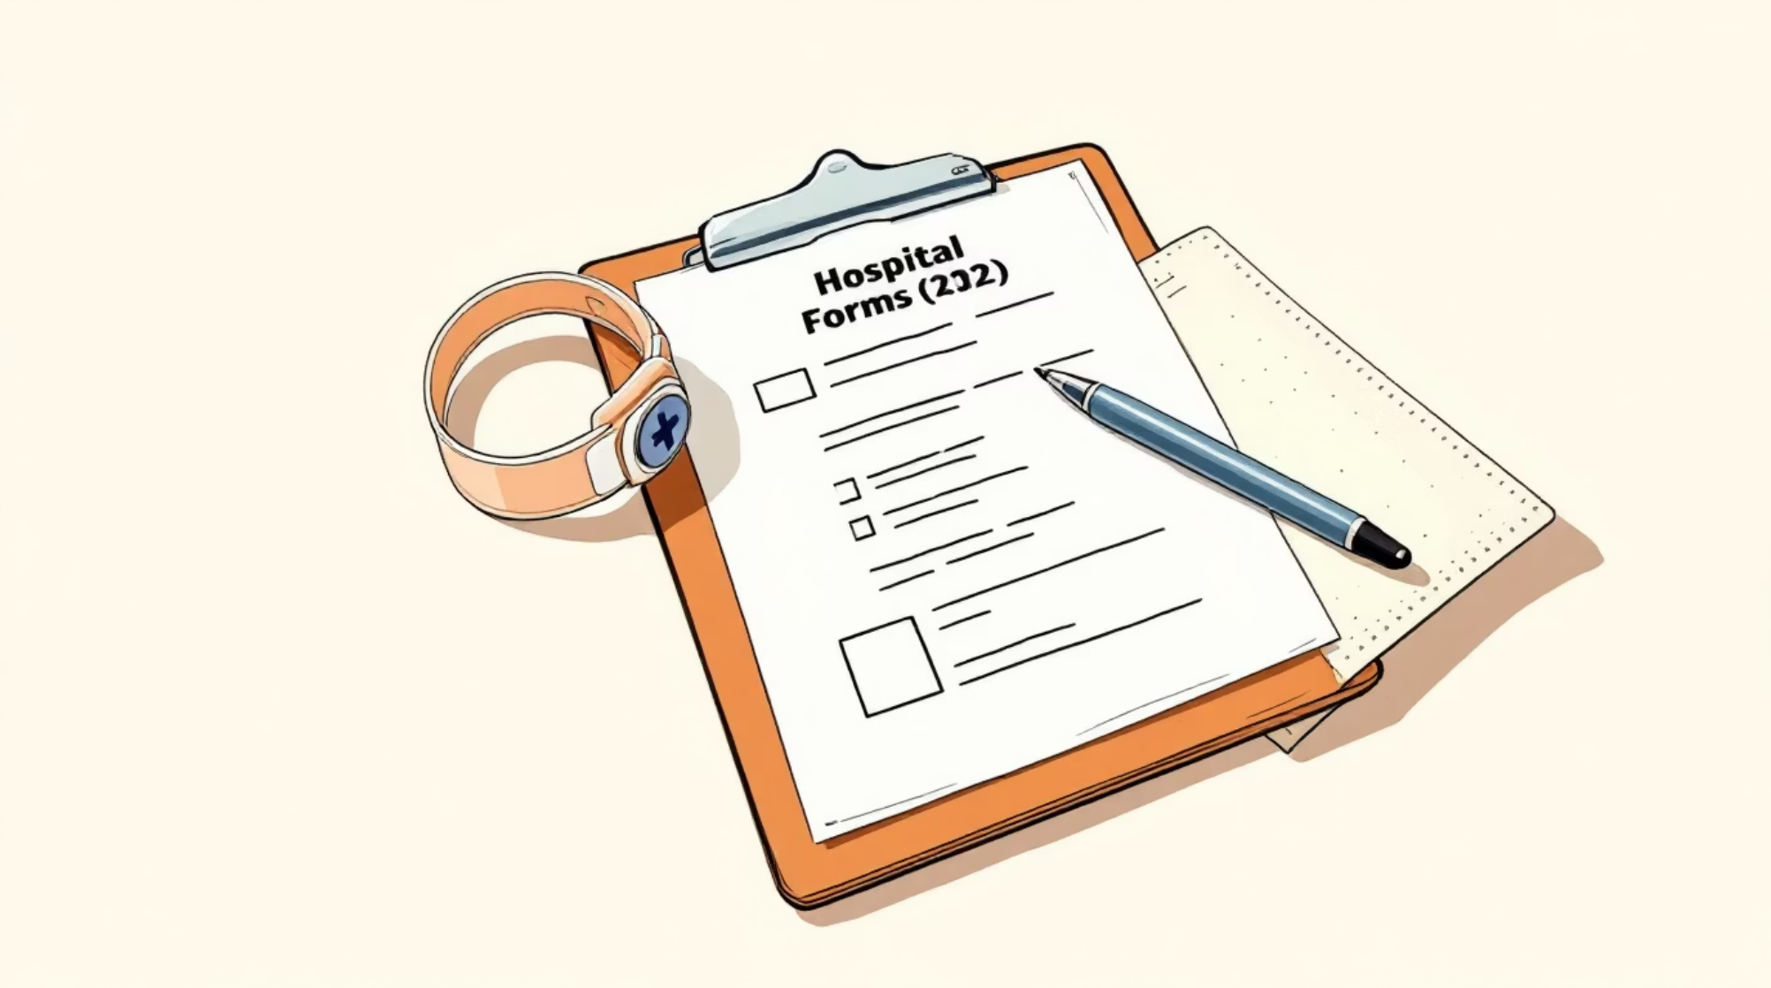
Dataset Snapshot: Comprehensive Patient & Operational Metrics
Key features captured include demographics (age, gender, race), clinical metrics (time in hospital, lab procedures, medication counts), operational fields (admission type, discharge disposition, nurse_required_count), and medical details (diag_1/2/3, glucose, A1C, diabetes medication changes).
Rows: 101,766 • Columns: 49
Avg length of stay: 4.40 days
Avg lab procedures: 43.1 • Avg medications: 16.0

Slide 4


Key Finding: Diabetes Medication & Re-admission Risk
Patients on diabetes medication show a higher average inpatient visit rate (0.65) versus non-medicated patients (0.57). This gap suggests weaker outpatient continuity or medication management for diabetics and an opportunity for targeted interventions to lower readmissions.
Clinical implication
Increase post-discharge follow-up and medication reconciliation for diabetic patients.
Operational implication
Monitor readmission trends by medication status to prioritize care management resources.

Slide 5

High Acuity Patients Drive Nursing Demand
Low Acuity
Minimal nursing support needed
Medium Acuity
Moderate nursing demand and coverage
High Acuity
Significant increase in nurse_required_count
Segmenting by acuity_score reveals a "High Risk" cohort with consistently higher resource needs (longer stays, more lab tests, greater medication counts). Prioritizing staffing to these segments improves throughput and outcomes.
High-acuity patients were flagged with elevated nurse_required_count — identifying these patients enables proactive staffing adjustments.
Why it matters
Quick action
Reduces delays, lowers complication risk, improves patient experience.
Shift flexible nursing capacity toward peaks in high-acuity census.

Slide 6

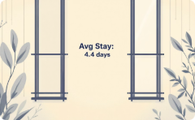
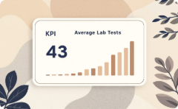
Power BI Dashboard: Operational Snapshot
Total Patients
Avg Stay
Avg Lab Tests
~102K records summarized for enterprise-level insights
4.4 days — used for capacity planning and benchmarking
43 procedures per visit — opportunity to optimize test ordering
The dashboard also includes a donut for Race & Gender distribution, a bar chart comparing Admission Type vs. Time in Hospital, and a column chart showing Historical Loss by age group (70–80 highest impact).

Slide 7


Business & Clinical Recommendations
Optimize staffing: Concentrate nursing resources on high-acuity patients and the 70–80 age bracket to reduce bottlenecks and improve outcomes.
Diabetes care management: Implement a Post-Discharge Wellness program that includes medication review, early follow-up calls, and community referrals to reduce readmissions.
Lab process streamlining: Audit lab utilization for patients with stays >5 days and create targeted order sets to eliminate unnecessary testing.
Use the dataset to operationalize interventions (triage rules, staffing rosters, and targeted care pathways).

Slide 8

Aligning with 2026 Trends: Patient Flow & AI Integration
Throughput and predictive staffing are strategic priorities. AI-enabled forecasting can predict admissions and high-acuity surges, enabling dynamic nurse scheduling and proactive bed management.
Predictive staffing
Forecast demand to reduce overtime and understaffing risks.
Flow redesign
Simplify discharge pathways to free beds and lower length of stay.

Slide 9

Overcoming Operational Challenges
Engage frontline staff to uncover real-world bottlenecks and test process changes in pilots.
Design decision-support that makes the right clinical/operational choice easy at the point of care.
Establish data-driven governance to monitor KPIs and sustain improvements.
Blend clinical insight with operational rigor: small pilots, rapid measurement, and scaled rollouts.

Slide 10

Conclusion: Data-Driven Care for a Resilient Hospital Future
Leveraging the 101,766-record dataset reveals clear opportunities: prioritize high-risk groups, redesign staffing for acuity-driven demand, and implement targeted diabetes follow-up to lower readmissions. Combining dashboards, predictive analytics, and frontline engagement will drive measurable improvements in patient care and operational efficiency.
Next Steps
Pilot post-discharge program for diabetics; implement acuity-based staffing; optimize lab order sets.
KPIs to track
Readmission rate, avg length of stay, nurse utilization, historical loss by age group.

